Slide 1
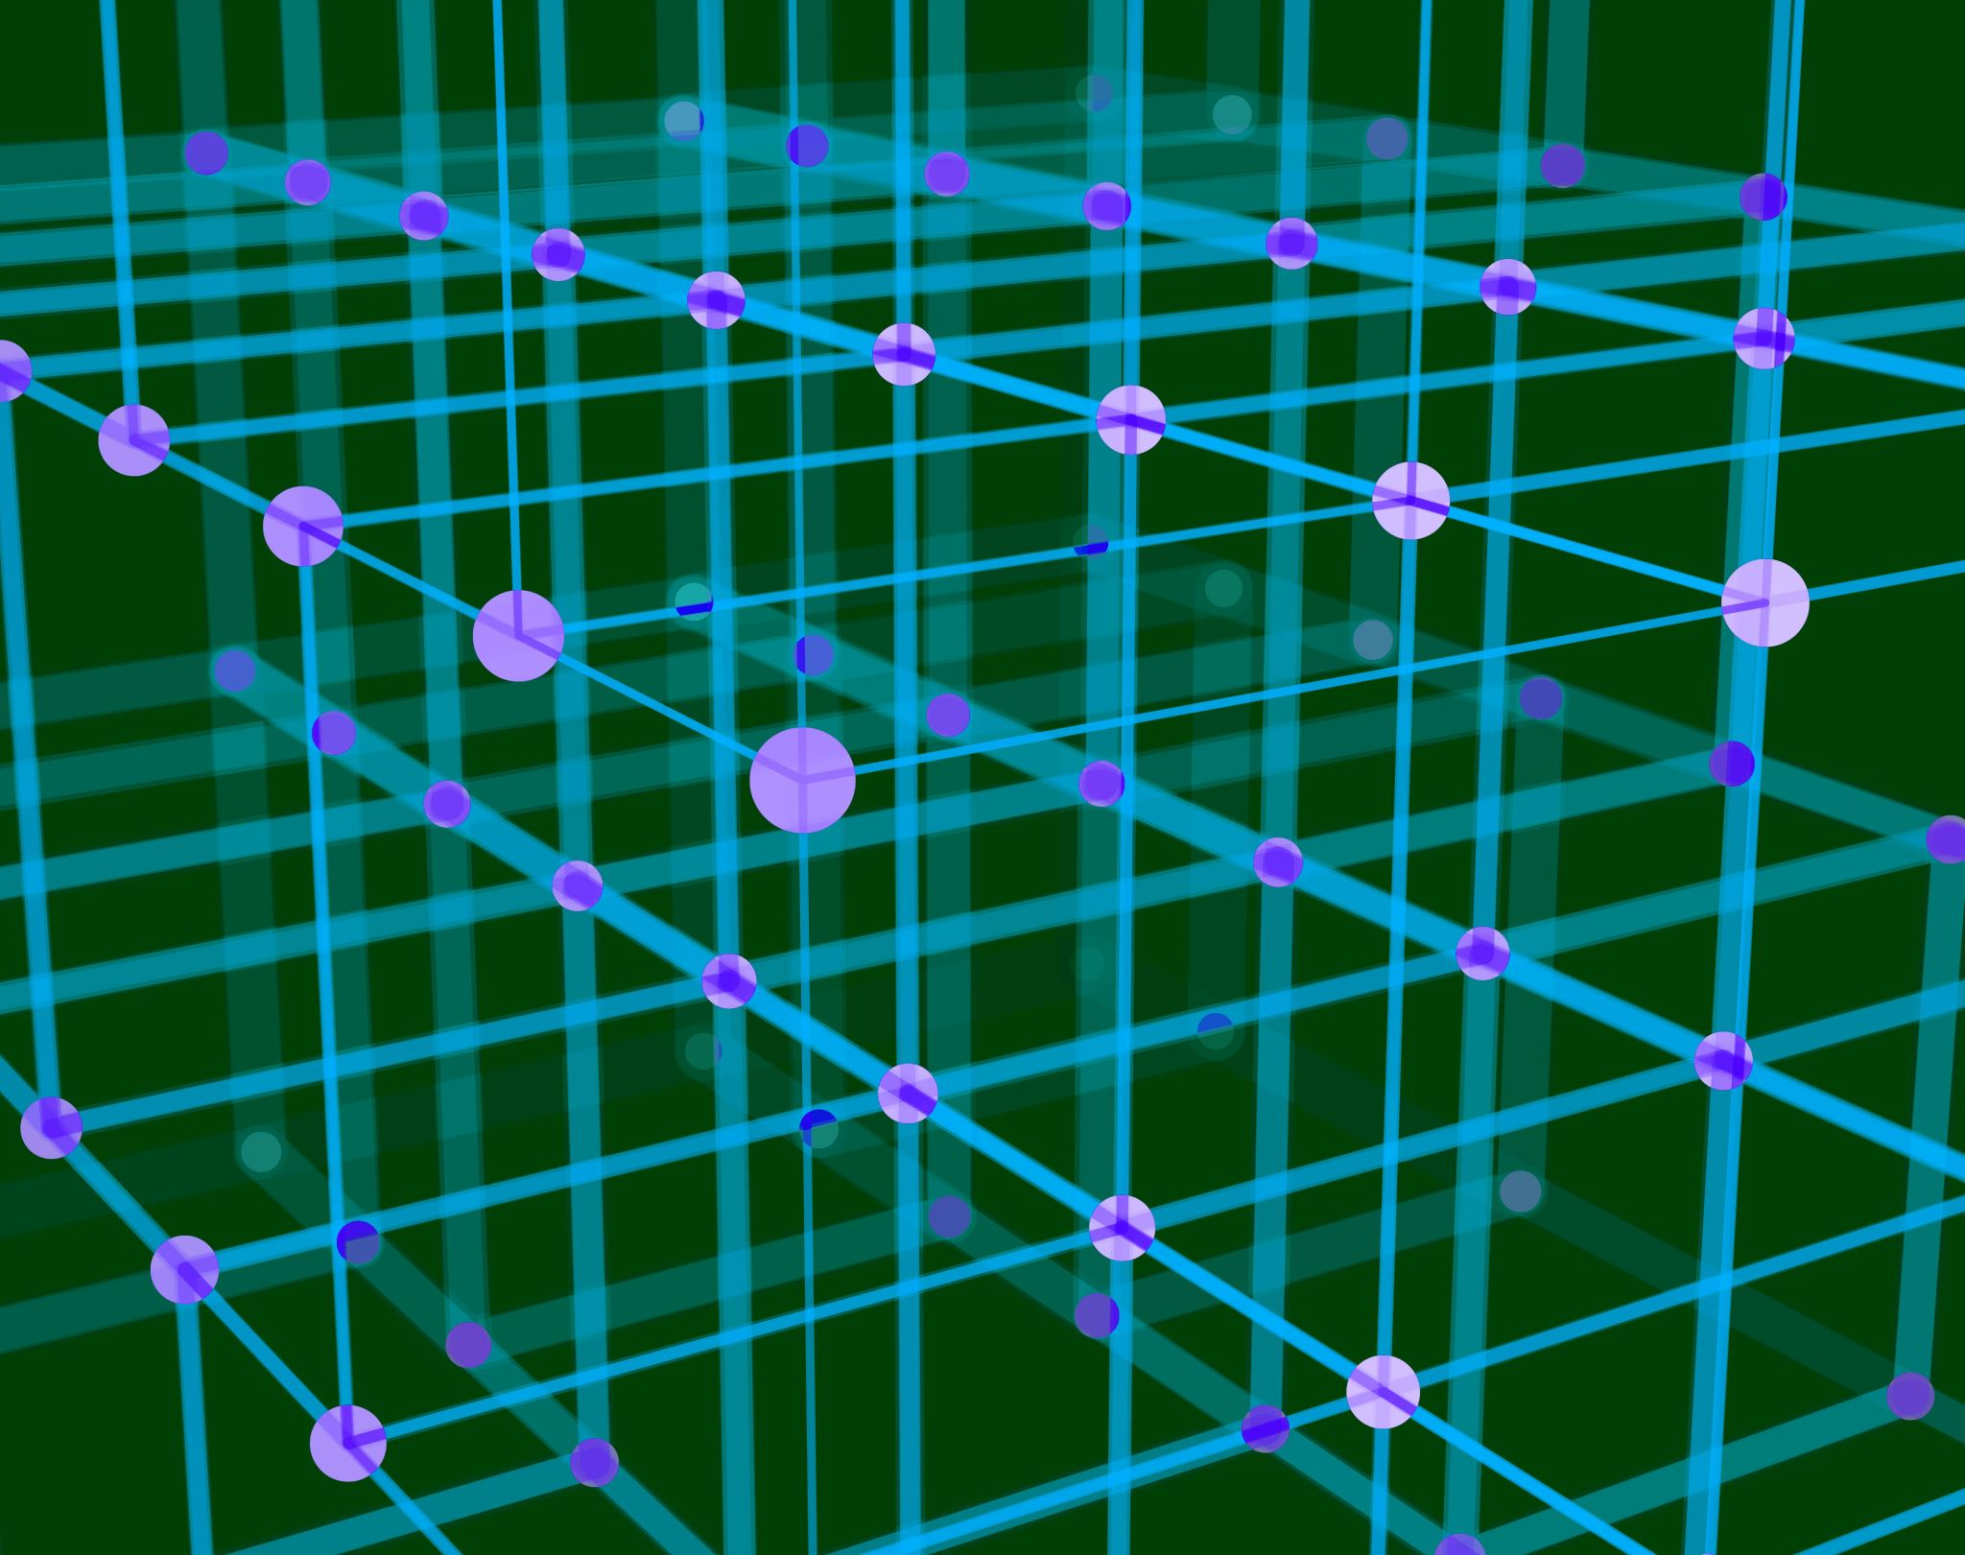
Parallel Raster Computations using Dask

Slide 2
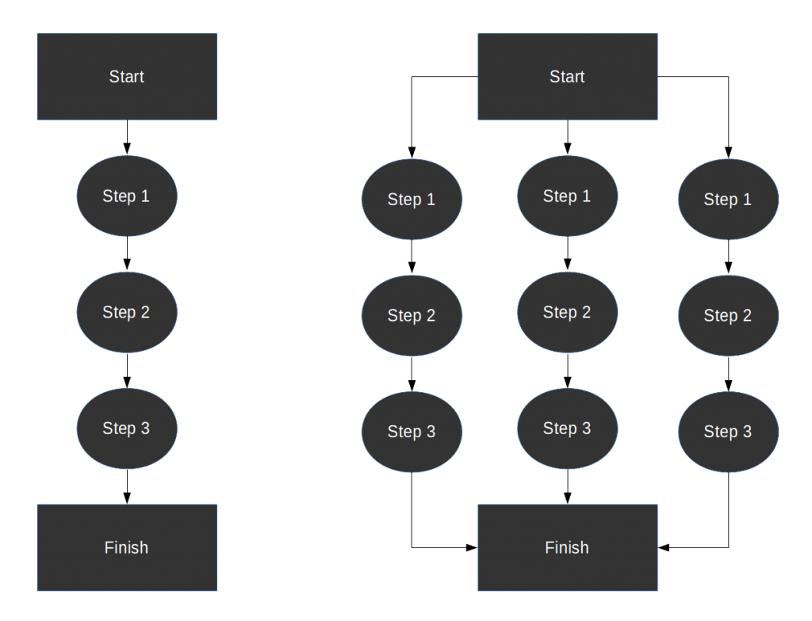
Serial vs Parallel Processing

Slide 3
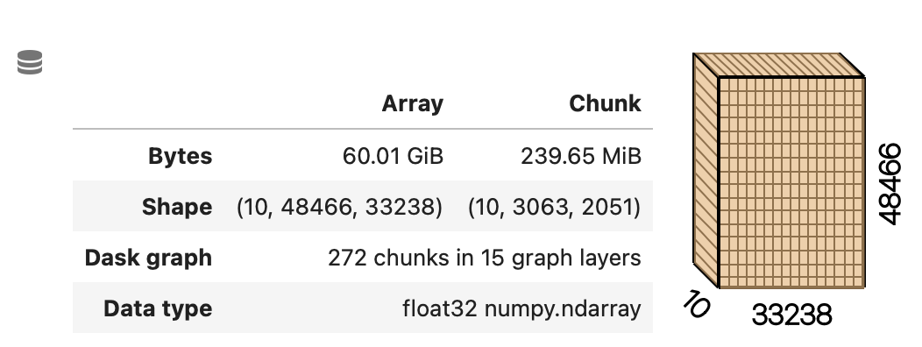
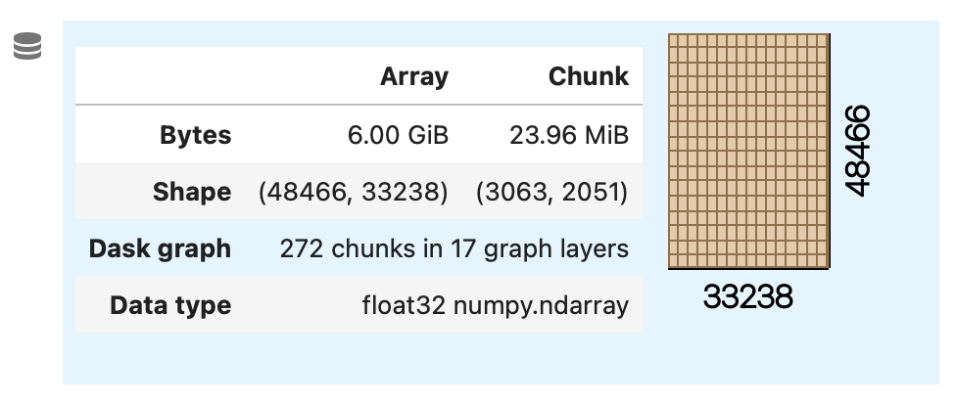
Why do we need parallel raster computation?
Example
Calculate maximum NDVI of Mozambique for 10-days
Sentinel-2 NIR and Blue bands
No-data masking (float32)
40 meter resolution
Issues
Loaded data size > RAM capacity
Raster computations often involve applying the same operation to different data pieces
Ex.: sum operation to all matching grid-cells
10-days NIR and red bands of Mozambique with 40 meters resolution
Expected output of maximum NDVI

Slide 4
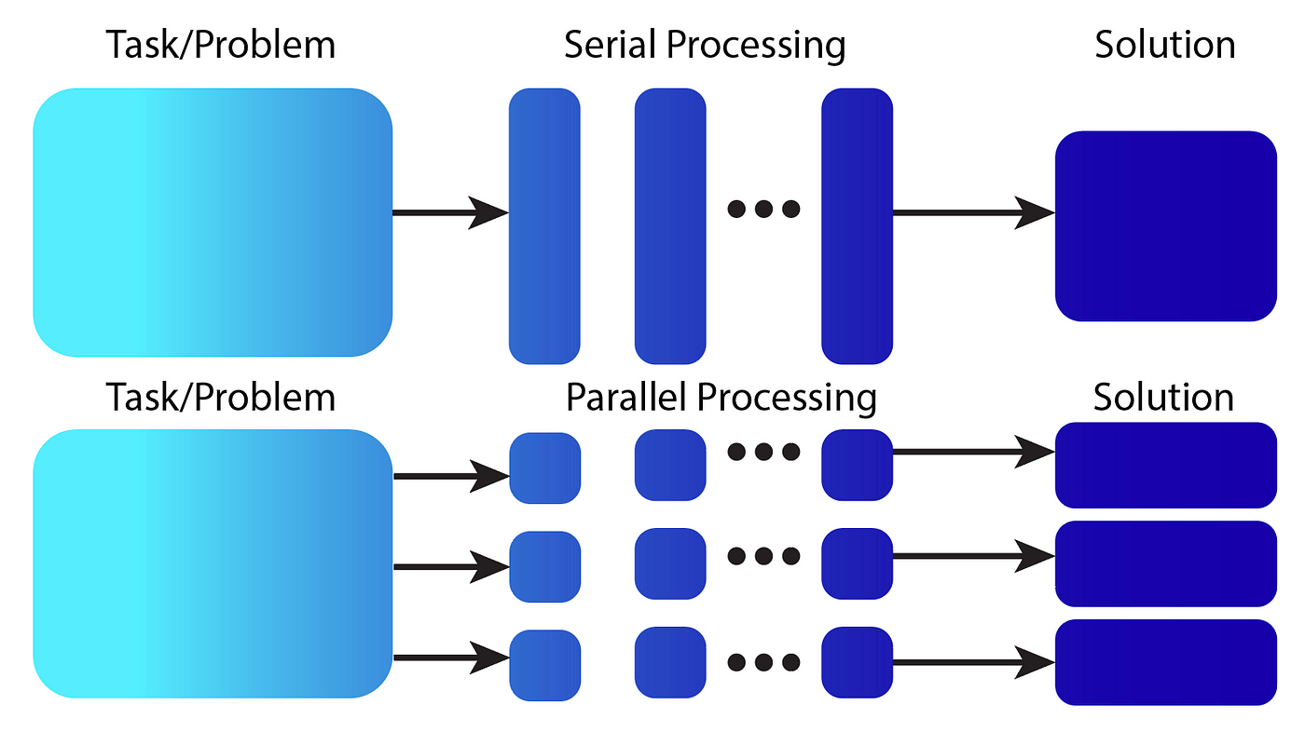
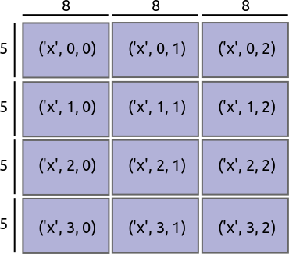
Benefits of Doing Raster Computation in Parallel
Chunking Mechanism
Compute data which is larger than the memory capacity
Distribute Task
doing similar function on different data in parallel

Slide 5
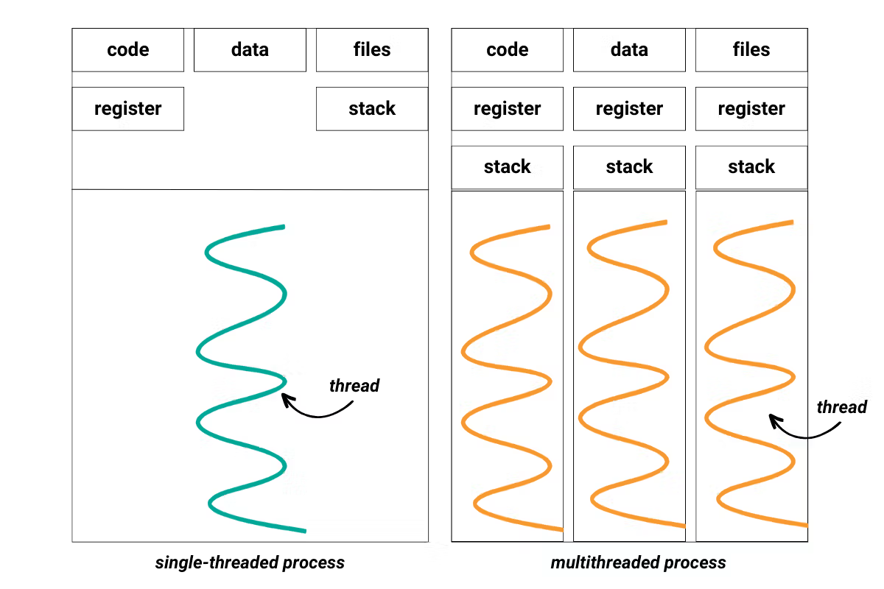
Multithreading

Slide 6
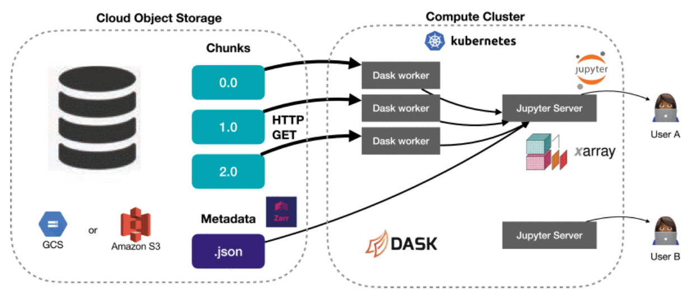
Example Workflow and Architecture

Slide 7
Key Considerations on Raster Parallel Processing
Chunk sizes matters
Don’t do parallel if:
The data is small enough to be handled by your computer
Overhead of communication and scheduling > processing
If too big, they may not fit in worker’s memory
If too small, there is overhead in scheduling and data exchange between worker

Slide 8

Github Repo
https://github.com/bhawiyuga/workshop-python-geospatial

Slide 9
Dask Representation
Dask operation is lazy
Operations are represented as task graph

Slide 10
Xarray: DataArray and DataSet

